Slide 1
… from a different angle?
Mixed Methods’ in the Humanities? – Support for Projects Combining and Synergizing Qualitative-Hermeneutical and Digital Approaches
Kick off-Meeting, Hannover, 29/30 May 2017
from “Mixed Methods” to “Original, isn’t it”

Slide 2
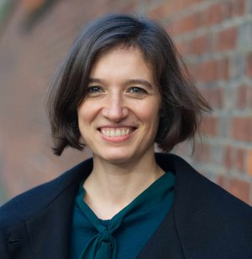
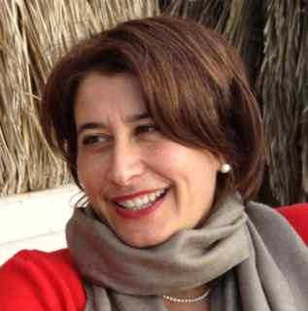
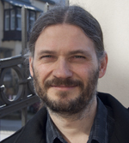
Modelling between digital and humanities: thinking in practice
Arianna Ciula King‘s College London King‘s Digital Lab
Cristina Marras Consiglio Nazionale d. Ricerche ILIESI
Øyvind Eide University of Cologne / (Passau) HKI/Institute for DH
Patrick Sahle University of Cologne CCeH
+ Nils Geissler, Elli Reuhl, Zoe Schubert, Julia Sorouri, Michela Tardella, N.N.
"Original - isn't it?" New Options for the Humanities and Cultural Studies April 2016 – March 2018

Slide 3
context
argument
hypothesis
strategy
activities
outcome

Slide 4
context
interdisciplinary research
Digital Humanities
practice
theory
critique
modelling in other traditions /disciplines
humanities
sciences

Slide 6
argument
modelling as creative process of thinking/reasoning
making and manipulation of meaning through external representations
modelling as research strategy

Slide 7
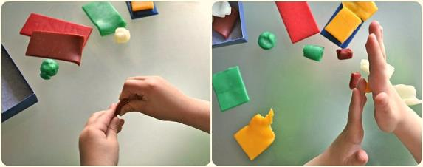
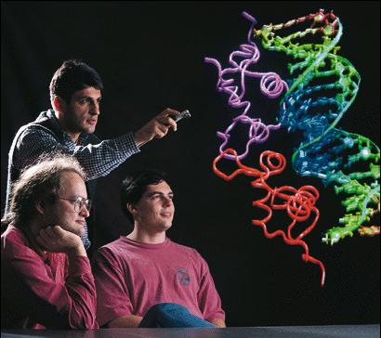
Creative process of thinking/reasoning
Meaning made and negotiated through creation and manipulation of external representations
Model as activity
Process by which researchers make and manipulate external representations (“imaginary concreta”, Godfrey-Smith 2009) to make sense of objects and phenomena

Slide 8
hypothesis
modelling as a process of signification (semiotic approach)
making sense via practical thinking
model of modelling to grasp relational aspects
role of models in scholarship and society

Slide 9
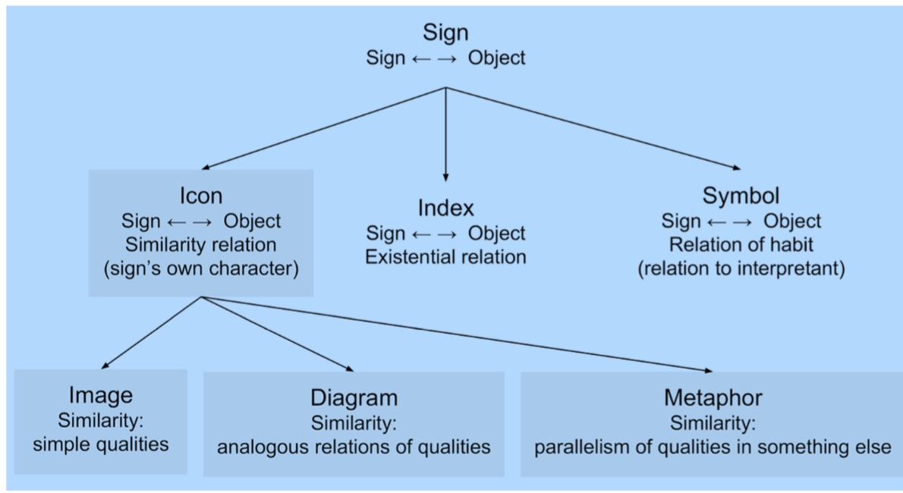
Semiotic framework: Models as Icons?
Ciula and Eide 2015 based on Kralemann and Lattmann 2013, fig 2

Slide 10
strategy
reasoning on the basis of research literature
observation of modelling activities
engage in modelling (more or less formal models)
case studies on text and events
visualization of models (and metamodels)

Slide 11
The Pragmatic (metaphorical) modelling
Act of interpreter
Objects
e.g. Texts = Oi (Properties)
Observer
DH Scholar = Obs (Theory)
Oi+Obs = Omod
(Modelling)
language / metaphors

Slide 12
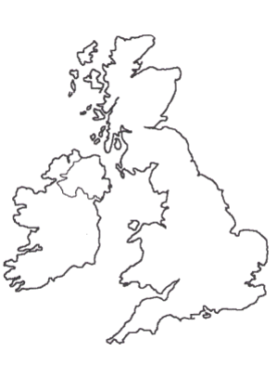
case study: text
modelling, text
“What is text? I am not so naive as to imagine that question could ever be finally settled. Asking such a question is like asking ‘How long is the coast of England?’”
Jerome McGann: Dialogue and Interpretation at the Interface of Man and Machine. Reflections on Textuality and a Proposal for an Experiment in Machine Reading. In: Computers and the Humanities 36/1 (2002), S. 95-107 [S. 96]. Online: <http://www2.iath.virginia.edu/jjm2f/old/chum2000web.html>.

Slide 13
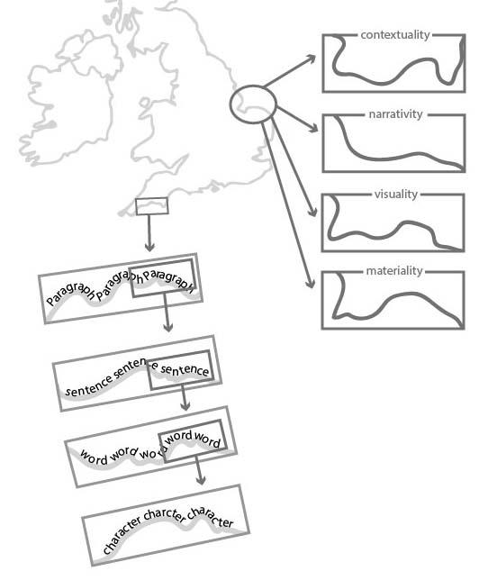
case study: text
text: ‘How long is the coast of England?’
text is what you look at and how you look at it
looking closer / zooming in
looking through different lenses
the coast of england is not the coast of japan

Slide 14
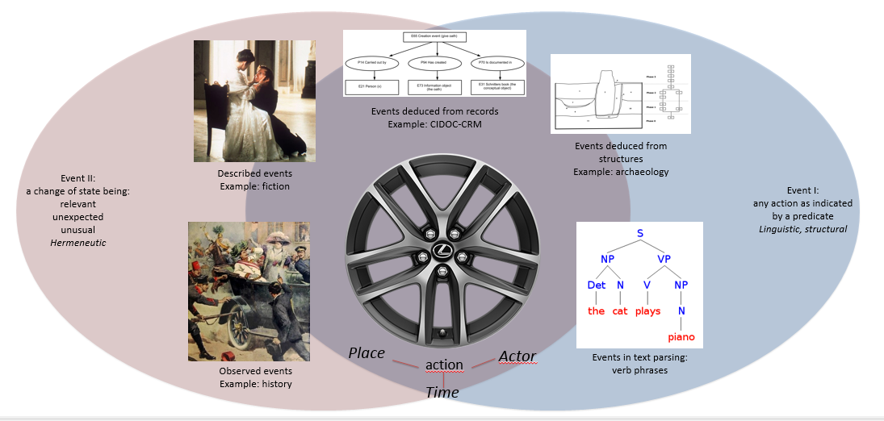
case study: events

Slide 15
activities
read, listen and learn
translate verbal models into diagrams
resonate and write
engage with the communities (conferences)
organize an invited experts workshop
create and run interdisciplinary labs

Slide 16
Interdisciplinary labs, I linguaggi della ricerca: parole e immagini (The languages of research: words and images)
Third lab, Naufragi e Terre Nuove (Shipwrecks and New Lands) 05/22/2015, h 03.00 – 06.30 pm Digital Library, Consiglio Nazionale delle Ricerche, Piazzale A. Moro 5, Rome
Second lab, Navigare la Ricerca (Sailing Research) 09/26/2016, h 03.00 – 06.00 pm Digital Library, Consiglio Nazionale delle Ricerche, Piazzale A. Moro 5, Rome
First lab, Riti – Passaggi – Visioni – Linguaggi (Rites – Passages – Visions – Languages) 03/21/2016, h 03.00 – 06.00 pm Digital Library, Consiglio Nazionale delle Ricerche, Piazzale A. Moro 5, Rome

Slide 17
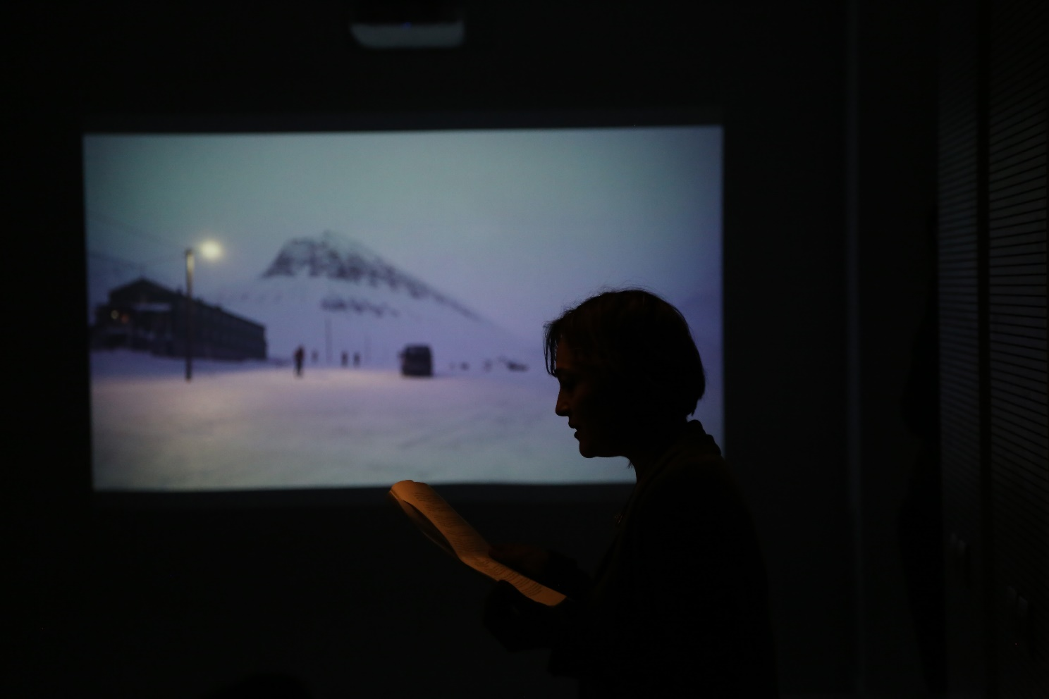
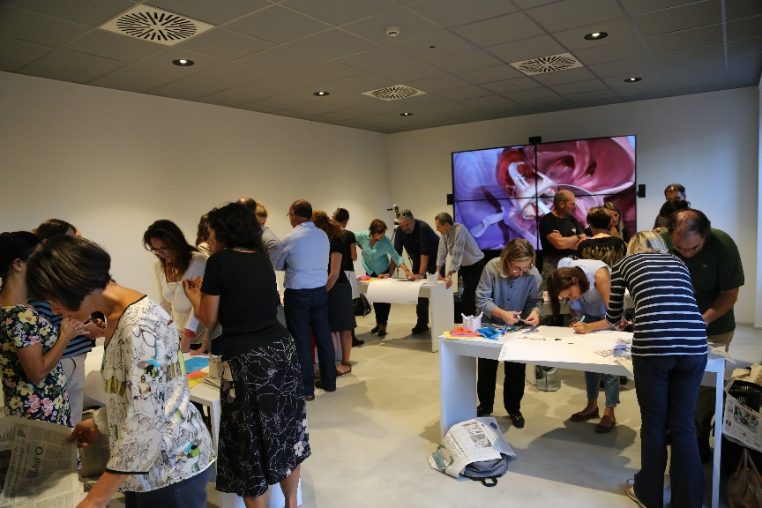
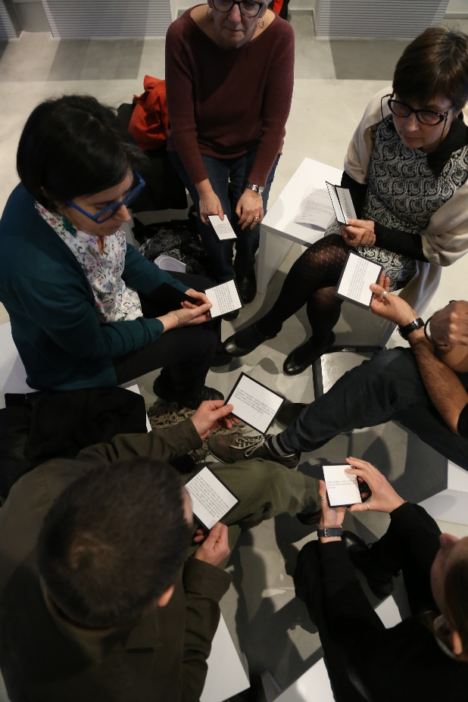
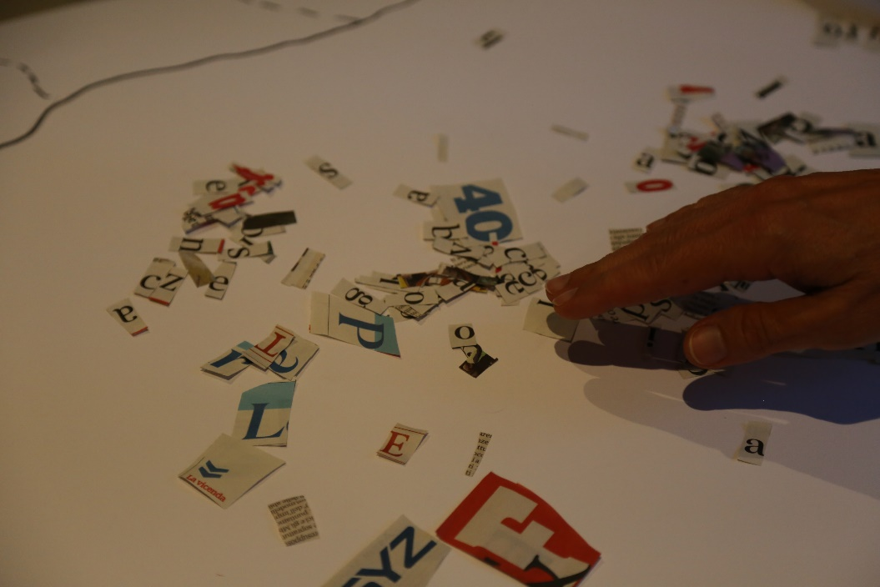
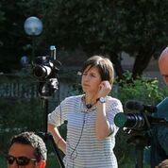

Slide 18
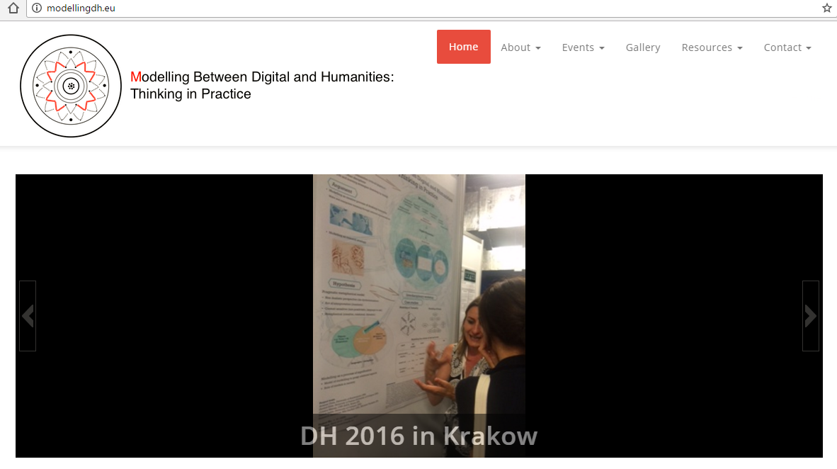
outcome
website
workshop proceedings
book on modelling
…

Slide 19
Some traditional outcomes …
Workshop proceedings
Willard McCarty; Nina Bonderup Dohn; Barbara Tversky; Christina Ljungberg; Rens Bod; Fotis Jannidis; Oliver Nakoinz; Gunnar Olsson; Claas Lattmann; Giorgio Fotia; Paul Fishwick; Günther Görz; Francesca Tomasi
Digital Humanities; Computer Science; Cognition; Literary Studies; Archaeology; Geography; Mathematics; Philosophy
Contexts/Paratexts by the researchers
Monograph
Towards a new language for modelling
Modelling and metaphoric reasoning
Modelling as semiotic process
Modelling as media transformation
Metamodelling in Digital Humanities
Case Studies in modelling: Text, Events
Digital Humanities at the core of a new cultural literacy

Slide 20
other outcomes …
?

